Slide 1
Introduction to XNA Programming
Introduction to Game Design and Development
ITCS 4230/5230
Dr. Dewan Tanvir Ahmed
Department of Computer Science
University of North Carolina at Charlotte

Slide 2
Objectives
Get started with C#
Learn the basic structure of games made using XNA
Use basic 2D graphics
Use basic input devices (Keyboard and mouse)
Moving objects
Etc.

Slide 3
Introduction
XNA is a cross-platform framework for game development
  Windows and Xbox 360
Good option for console games
All needed tools can be downloaded for free:
  http://creators.xna.com

Slide 4

.NET Framework
Virtual Machine similar to Java
CLR is the VM that runs the code using JIT
  Just-in-time compiling
  Available for different platforms

Slide 5
C# Language
Specifically designed for .NET
Similar to C++ and especially Java
  Somewhere in between
Visual Studio as the only IDE
  Express or Professional editions
Uses .NET framework class library
Includes Java-like features like garbage collection, no pointer, etc.

Slide 6
C# Data Types
Value types (hold actual value)
  byte, int, float, bool, etc.
  User-defined structures
    int i = 5; int j = i; //2 objects with same value
Reference types (hold pointer/ref.)
  class, interface, delegate
    MyClass m1 = new MyClass();
    MyClass m2 = m1; //only a reference to value

Slide 7
C# Classes and Objects
Every variable is in fact an object (from base class Object)
All objects have a series of basic methods
  ToString() is a common example
Similar to C++, you can use static methods of library classes without creating an object
  MessageBox.Show(“test”);

Slide 8
C# Programs
using System;
  Similar to #include in C/C++
  Access to class library
namespace WindowsApplication1
  A hierarchical grouping methods for classes
static void main()
  Must exist in one of the classes as entry point to the program
  Creates initial objects

Slide 9
DirectX and Direct3D
DirectX is the Microsoft package of multimedia APIs
More efficient access to hardware through special drivers
Direct3D is the graphics part of DirectX
  Similar to OpenGL
  Managed DirectX for .NET

Slide 10
Xbox
512 MB of RAM
DirectX 9 GPU
3 RISC PowerPC cores with two hardware threads on each running at 3.2 GHz
  No CPU-level code optimization
    Bad news for JIT compiler
    Be more “optimized” when coding

Slide 11
XNA
XNA is a series of C# library classes
Uses (but hides) Managed DirectX
Includes features that may be specific to Windows or Xbox but is generally portable
  #if !XBOX
    KeyboardState k = Keyboard.GetState();
  #endif

Slide 12
XNA Links to Get You Started
All from rbwhitaker.wikidot.com
  setting-up-xna
  xna-project-template
  managing-content
  the-content-pipeline

Slide 13
Visual Studio Notes
Turn on line numbers
  Tools > Options
  Check ‘Show all settings’ (lower left corner)
  Click on ‘Text Editor’
  Click ‘All Languages’
  Check ‘Line numbers’ box (display options)
Use your Intellisense (Link)
Learn the keyboard shortcuts (F5 to debug, breakpoint F9, etc.)

Slide 14
VS Windows
Standard Tools
  Error List
  Output
  Find Symbol Results (Find All References)
  Breakpoints

Slide 15
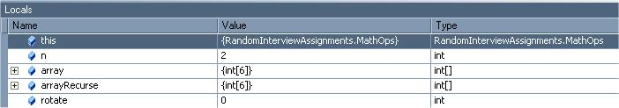
Debugging Tools - Local
Shows local class data
Editable
Shift location with call stack or stepping through

Slide 16

Debugging Tools - Watch
Shows watched variables
  Right click add watch
  Type name in name field

Slide 17
Visual Studio Projects
Hierarchical structure of files
  Solution (group of related programs, .sln file)
  Project (one executable program, .csproj or .vcproj files)
  Source and data files
Projects can be in a subdirectory of solution or all in the same directory
In XNA there is a directory called Content under project directory
You can organize your files by creating new subdirectories

Slide 18
XNA Projects
Can use Windows or Xbox as target
  Code and content can be shared but project setting is different
Xbox projects need to be “deployed” to console (on the same LAN)
  Log into Live, go to Marketplace, purchase “Creator’s Club” membership
  Download and install XNA and its tools on Xbox
  Run Game Studio Connect (from Games tab)
  Deploy your game from PC

Slide 19
Creating a New XNA Project
Start Visual Studio
Select File/New/Project
Select VC#, XNA, Windows Game
Give a name
Add code and data to the default project

Slide 20
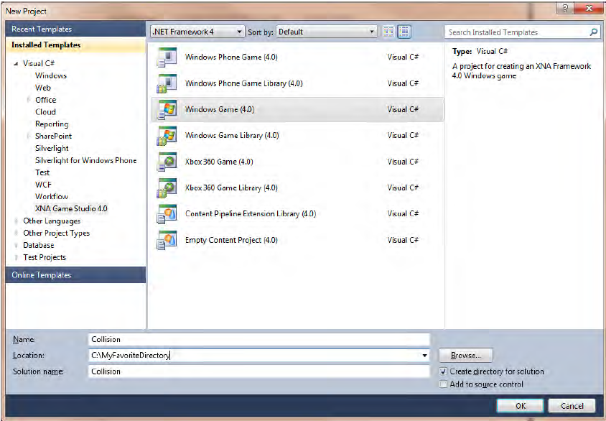
New Project Creation

Slide 21
XNA Game Structure
Couple of class-level variables
  GraphicsDeviceManager
    very important object
    provides a way to access the graphics device on your PC, Xbox 360, or Windows Phone 7 device.
    It has a property - GraphicsDevice
      that represents the actual graphics device on your machine.
      Check its properties (may need in future!)
    everything you do on the screen in your XNA games will run through this object.

Slide 22
XNA Game Structure
Couple of class-level variables
  SpriteBatch class
    a sprite is defined as a 2D or 3D image that is integrated into a larger scene.

Slide 23
XNA Game Structure
Five methods
  Initialization
  LoadContent
  UnloadContent
  Update
  Draw

Slide 24
XNA Game Structure
Initialization
  initialize variables (like score values) and other objects associated with your Game1 object
LoadContent
  Can be called anytime if graphics content of the game needs to be reloaded
  Loads –
    Image
    Model
    Sound

Slide 25
XNA Game Structure
Game loop consists of only two methods:
  Update and
  Draw.
All logic that affects the actual game play will be done in the Update or the Draw method.
Update
  involve moving objects, checking for collisions, updating scores, checking for end-game logic, etc.
Draw
  to draw things

Slide 26
XNA Content
Content pipeline:
  All graphics, sounds, effects, and other items are loaded in XNA through content pipeline
  XNA converts them during compilation to an internal format
Content has to be part of the project
You cannot use dynamically defined content
Common formats
  2D: most image formats
  3D: .X (model), .FBX (model/animation), .FX (shader effects)
  Audio: XACT (Cross-platform Audio Creation Tool is an audio programming library)

Slide 27
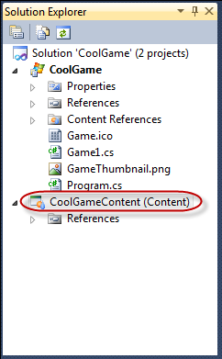
Adding 2D Content
Right-click on Content in Solution Explorer and add an existing image
  I prefer to create folder for each content type
  Create Image folder under Simple2DContent
  Add content (in this case cartoon.jpg)
Asset Name: give a name to your assest

Slide 28
Load your 2D Content
The default object used to store an image is Texture2D.
Add a class-level variable
  Texture2D texture;
Add these code into LoadContent method
  texture = Content.Load<Texture2D>(@"Images/cartoon");
  The Load method of the ContentManager class is a generic method that requires a type parameter indicating which type of variable you want to access.

Slide 29
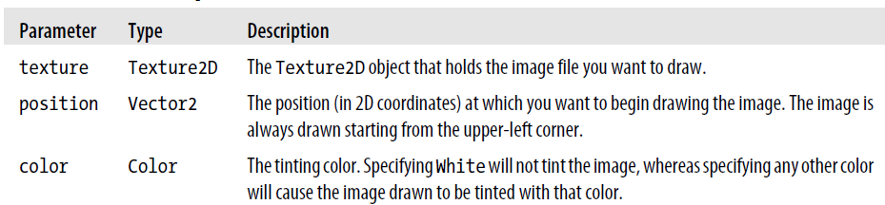
Draw your 2D Content
Add a SpriteBatch object to your Game class and initialize it in LoadContent function
Code of Draw method
    spriteBatch.Begin();
    spriteBatch.Draw(texture, Vector2.Zero, Color.White);
    spriteBatch.End();
XNA is telling the graphics device that it’s going to send it a sprite (or a 2D image)

Slide 30
Game Loop
Running through its game loop 60 times per second, erasing everything on the screen and painting it
Why do you want to clear the screen every single time?
  need to keep track of everything that moves in a scene from one frame to the next,
  draw the moved items in their new locations, and draw whatever was behind the object previously in the location from which the object has moved.
  Inefficient

Slide 31
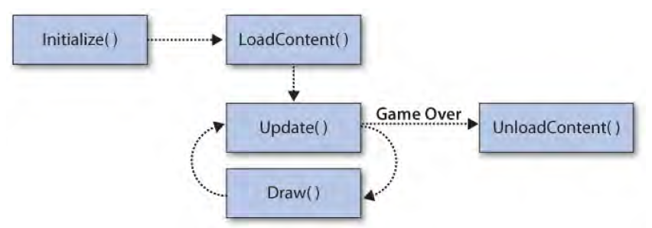
Game Lifecycle

Slide 32
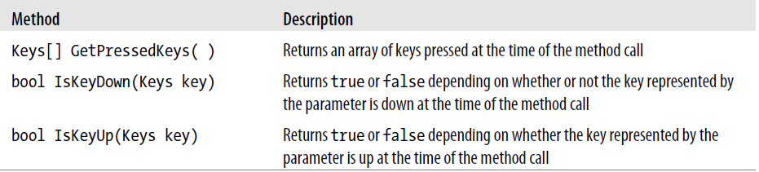
User Input and Move Object
Keyboard input is handled via the Keyboard class,
  Namespance Microsoft.XNA.Framework.Input
The Keyboard class has a static method called GetState that retrieves the current state of the keyboard in the form of a KeyboardState structure.

Slide 33
User Input and Move Object
  KeyboardState keyboardState = Keyboard.GetState();
  if (keyboardState.IsKeyDown(Keys.Left)){
  x--;
  }

Slide 34
User Input and Move Object
FYI – keep the object inside the window.
  Window.ClientBounds.Width (480)
  texture.Width
  Window.ClientBounds.Height (800)
  texture.Height

Slide 35
Movie an object using keys
KeyboardState ks = Keyboard.GetState();
if (ks.IsKeyDown(Keys.Left))
x = (x > 0) ? (x-1) : 0;
if (ks.IsKeyDown(Keys.Right))
x = (x < Window.ClientBounds.Width-texture.Width) ? (x +1) : x;

Slide 36
User Input and Move Object
XNA provides a Mouse class
The Mouse class also has a GetState method that you can use to get data from the mouse in the form of a MouseState struct.

Slide 37
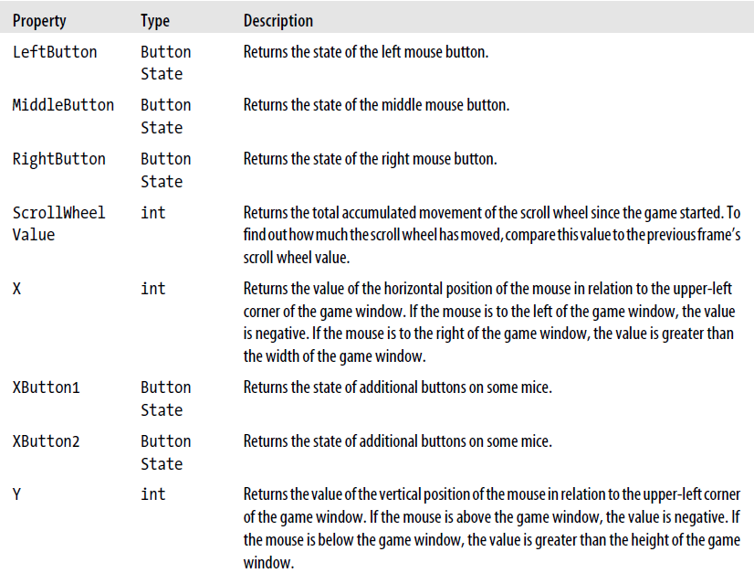
User Input and Move Object

Slide 38
Movie an object using Mouse
This is not complete … fix it?
MouseState ms = Mouse.GetState();
if (ms.LeftButton == ButtonState.Pressed)
{
x = (ms.X < Window.ClientBounds.Width - texture.Width) ?
ms.X : Window.ClientBounds.Width - texture.Width;
// do for Y
}

Slide 39
Visible Mouse Pointer
protected override void Initialize()
{
// TODO: Add your initialization logic here
this.IsMouseVisible = true;
base.Initialize();
}

Slide 40
And Now I Am Going to be Awful
Homework 1
  Due: Thursday, September, 17th
    Make the Solar System in XNA
    Tic-tac-toe in XNA
    Check Moodle for details
But why a homework now?
  Clear up programming requirements
  Show you can do this
  Easy way to get feet wet

Slide 41
Thank you!

